Slide 1
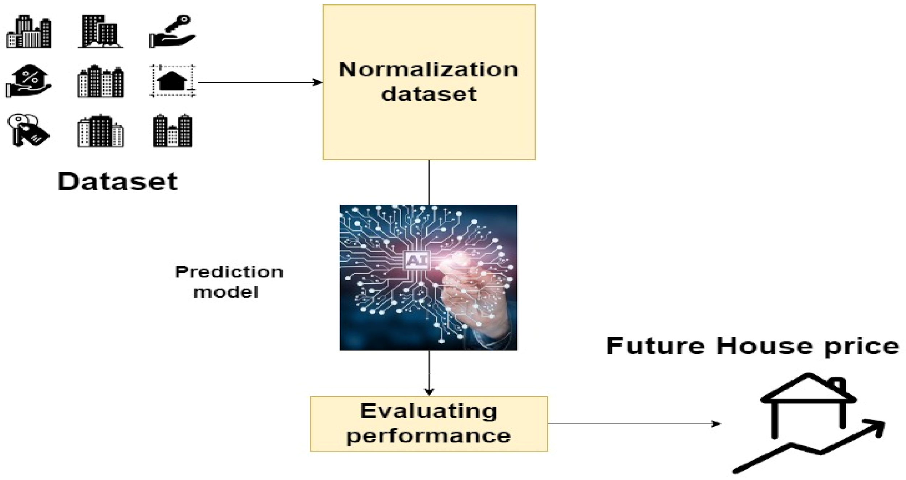
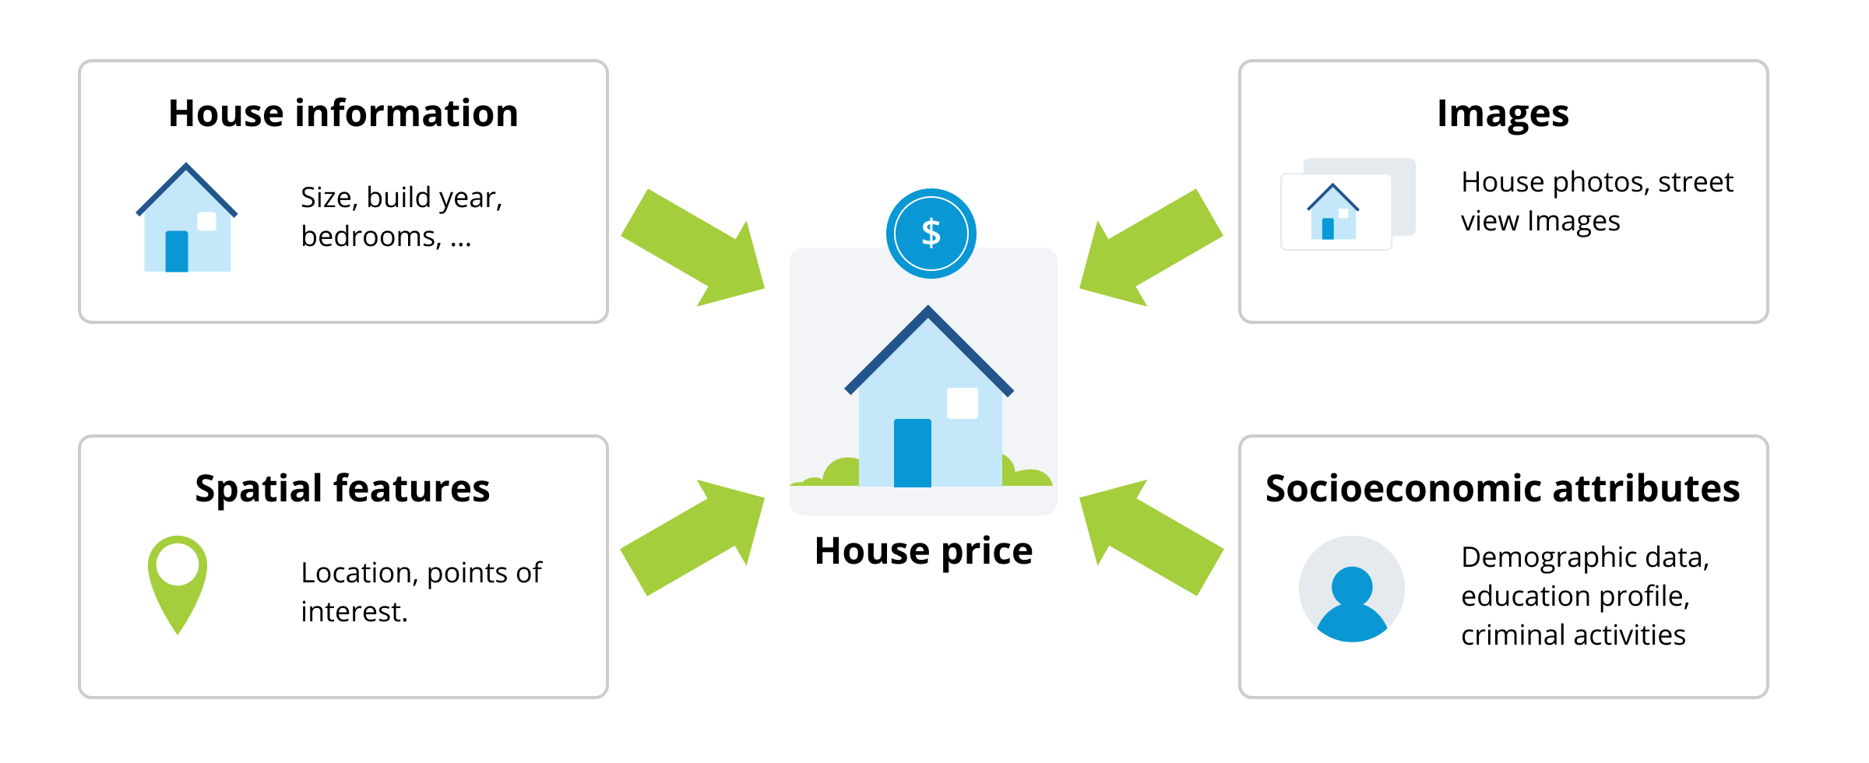
Smart Predictive Modeling for Rental Property Prices

Slide 2
Problem Statement >>>
In the real estate industry, determining the appropriate rental price for a property is crucial for property owners, tenants, and property management companies.
Accurate rent predictions can help landlords set competitive prices, tenants make informed rental decisions, and property management companies optimize their portfolio management.
The goal of this project is to develop a data-driven model that predicts the rental price of residential properties based on relevant features. By analyzing historical rental data and property attributes, the model aims to provide accurate and reliable rent predictions.
Expected Outcomes:-
The successful implementation of the house rent prediction model will provide property owners ,tenants, and property management companies with a tool to estimate rental prices accurately.
This will enhance transparency, aid in decision-making, and contribute to a more efficient and equitable rental market.

Slide 3
Tools Used >>>
Programming Languages:-
Python for data analysis and modeling.
Jupyter Notebook or Google Colab for collaborative development.
Libraries:-
Pandas, NumPy, Matplotlib, Seaborn for data manipulation and visualization.
Scikit-learn for machine learning models [Linear Regression, Random Forest, and Gradient Boosting]..
Evaluation Metrics like mean squared error, mean absolute error,etc.
Hyperparameter tuning using GridSearchCv.

Slide 4
Approaches >>>
Data Preprocessing:-
Imported necessary packages and loaded datasets (train_df and test_df).
Conducted data preprocessing, including handling missing values and data type conversion.
Also took a look on outliers as well handling of it was done.
Exploratory Data Analysis (EDA):-
Correlation Analysis: Visualized relationships between features using a heatmap.
Using different plots did univariate analysis.
Feature Selection: Identified key features for predictive modeling.
Modeling:-
Linear Regression:- Trained a Linear Regression model on selected features for a trial.
Random Forest and Gradient Boosting:-
Implemented and trained Random Forest and Gradient Boosting Regressor models.
Evaluated model performances using Mean Squared Error (MSE) and Mean Absolute Error (MAE).

Slide 5
Also tried the trained models on test_df dataset for a better idea of performance.
Hyperparameter Tuning:-
Used Grid Search CV to optimize Random Forest hyperparameters.
Results and Predictions:-
Generated rental price predictions for the test dataset.
Compiled results for side-by-side comparison with the original test dataset.
The results and evaluation metrics showed that RF Regressor was the most powerful prediction model than other both models as we predicted on both the datasets and accordingly compared.

Slide 6
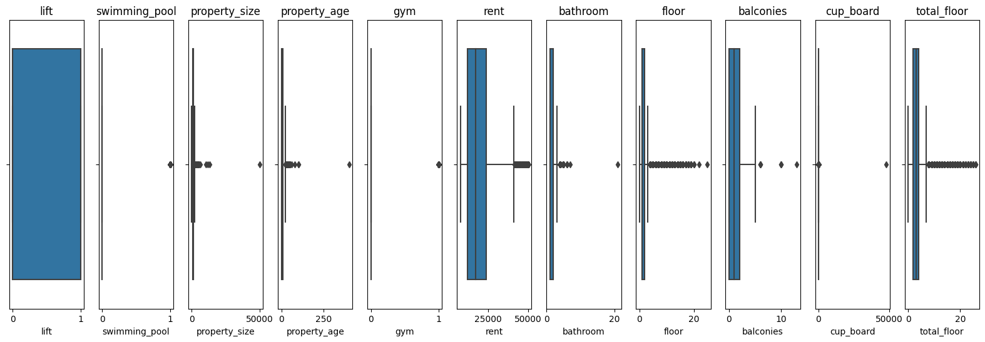
EDA Insights >>>
Outlier Insights[Box Plot]

Slide 7
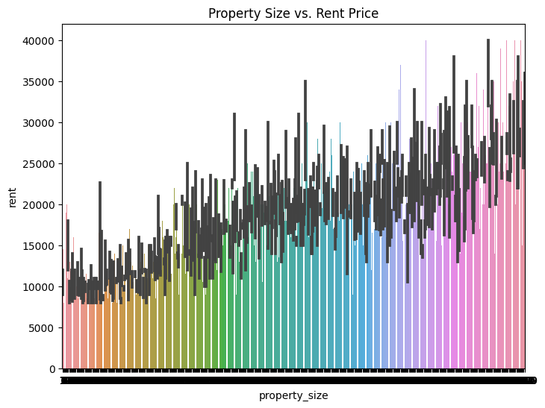
Univariate Analysis[Bar Plots]

Slide 8
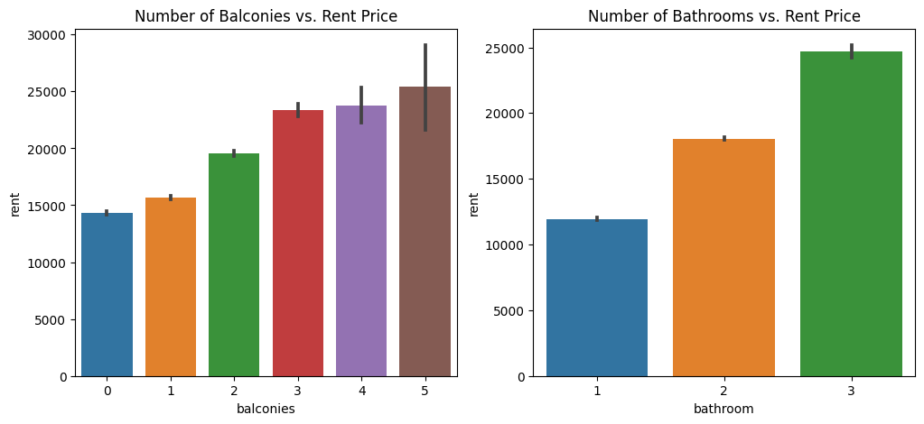
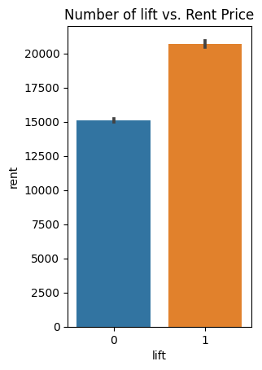
Continued >>>

Slide 9
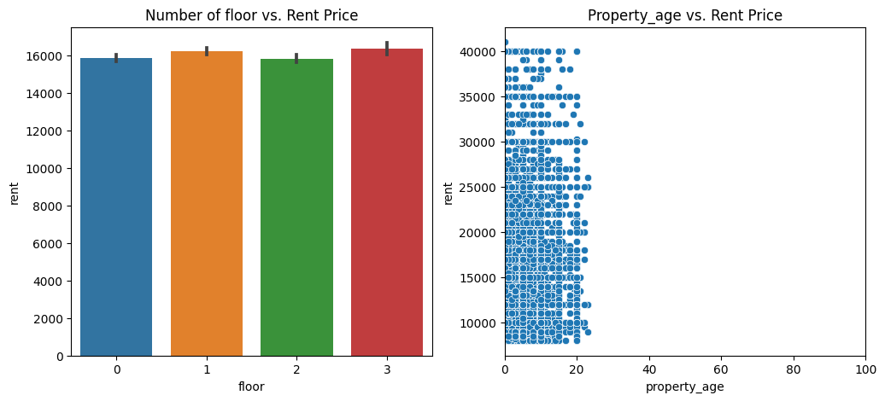
Continued >>>

Slide 10
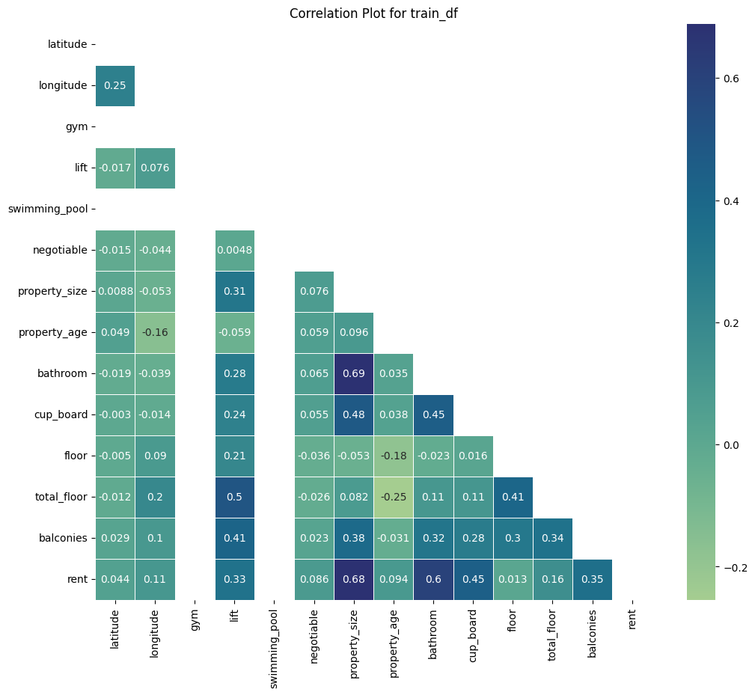
Correlation Analysis

Slide 11
CONCLUSION
Key Takeaways:-
Successful application of regression models for predicting rental prices.
Insights gained from EDA and feature selection.
Project Drive & Git Hub Link:-
https://drive.google.com/drive/folders/1uxUIFu8m6FlHMhdi611NaAqpWBTx97xO?usp=sharing
https://github.com/cprathamesh1997

Slide 12


